Slide 1

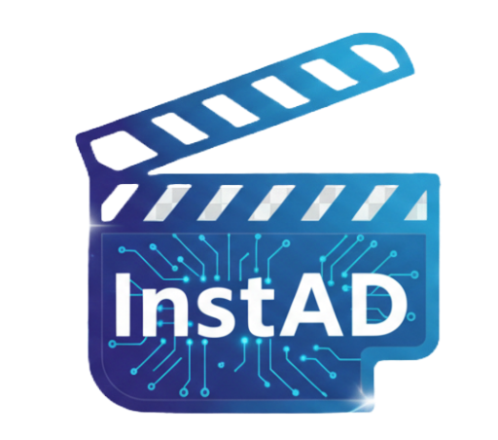
InstaAD
Advertisment AI Creator
Project Code: 25-2-D-26
Supervisor:
Zakharia Frenkel
Students:
Maor Siboni Daniel Ayash

Slide 2


Background & The Problem
The Need:
Video marketing is essential for any business today
The Cost: Traditional production is expensive & slow
The AI Barrier:
Existing AI tools are too complex
The Gap:
Small businesses without resources are left behind

Slide 3



Core System Requirements
Automated Simplicity
High Reliability
End-to-end video generation via a "One-Click" natural language interface, with no manual editing required.
Smooth UI (Asynchronous processing) and server availability
Dynamic Personalization
Data Management
"Adaptive Feedback Loop" to learn user preferences from past actions.
Secure storage for user profiles, generated videos, and ad history

Slide 4


The Solution & Tech Stack
Architecture
Frontend
Backend & Security
Client-Server model written entirely in Python
PyQt5 for an intuitive and responsive desktop GUI
FastAPI for high-performance RESTful API, secured with Argon2 (hashing)
AI Engines
Database
Deployment
Docker & Docker-Compose, GitHub Actions (CI/CD) with a built-in local fallback mechanism
MongoDB to store user profiles, history, and feedback data
Google Gemini 2.5 Flash Lite & KIE.ai Seedance 1.5 pro API

Slide 5
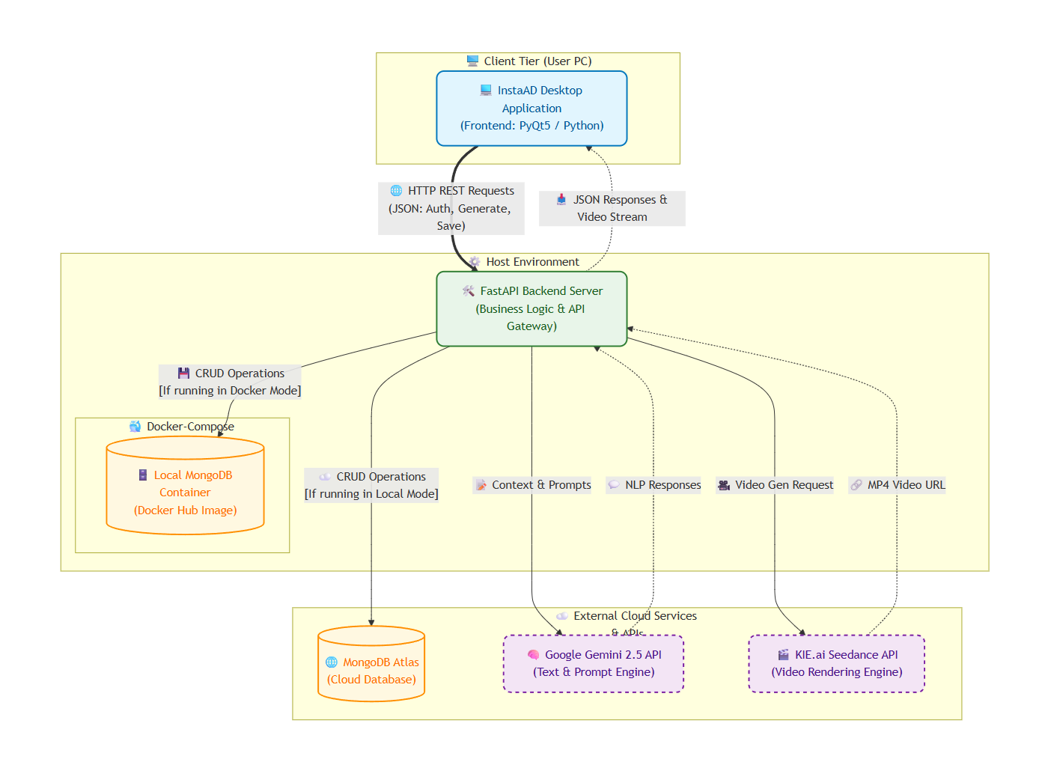
An automated, end-to-end pipeline from natural language input to rendered video.

Slide 6


Project Metrics & Achievements
Speed:
Usability
Full video ad generation in 50-60 seconds
"One-Click" interface with Hybrid Server fallback
Personalization
Stability
High ad relevance via the "Adaptive Feedback Loop "
Ensured zero UI freezes and no critical crashes

Slide 7
Engineering Challenges & Constraints
UI Freezing: Eliminated GUI blocking during video rendering using Qthread
.
Costs & Memory: Managed token limits and KIE.ai budgets via a MOCK
Deployment Dependencies: Built a "Hybrid Server Orchestration" fallback for host machines without Docker.
Media Playback: Replaced the failing native PyQt player by seamlessly embedding VLC
AI API Sourcing: Tested multiple AI video tools before successfully integrating the KIE.ai APi

Slide 8

Thank
You For Listening!

